Slide 1
Prim’s algorithm
Prim’s algorithm is a special case of the generic minimum-spanning-tree algorithm.
Prim’s algorithm has the property that the edges in the set A always form a single tree.
the tree starts from an arbitrary root vertex r and grows until the tree spans all the vertices in V.
At each step, a light edge is added to the tree A that connects A to an isolated vertex of GA = (V, A).
This strategy is greedy since the tree is augmented at each step with an edge that contributes the minimum amount possible to the tree’s weight.

Slide 2
Prim’s algorithm
In the pseudocode below, the connected graph G and the root r of the minimum spanning tree to be grown are inputs to the algorithm.
During execution of the algorithm, all vertices that are not in the tree reside in a min-priority queue Q based on a key field.
For each vertex v, key[v] is the minimum weight of any edge connecting v to a vertex in the tree;
by convention, key[v]=∞ if there is no such edge. The field π[v] names the parent of v in the tree

Slide 3
Prim’s Algorithm
MST-PRIM(G, w, r)
1 for each u ∈ V[G]
2 do key[u]←∞
3 π[u]← NIL
4 key[r] ← 0
5 Q ← V[G]
6 while Q ≠ ∅
7 do u ← EXTRACT-MIN(Q)
8 for each v ∈ Adj [u]
do if v ∈ Q and w(u, v) < key[v]
then π[v]← u
11 key[v] ← w(u, v)

Slide 4
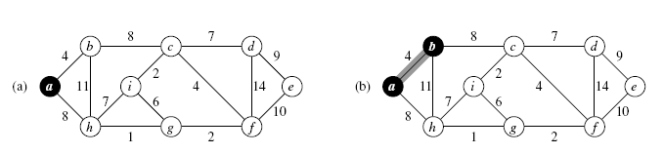
Example

Slide 5
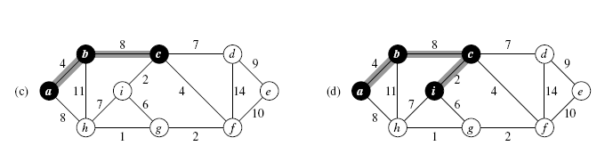
Example

Slide 6
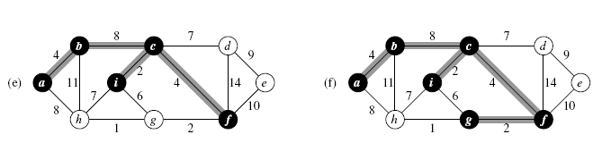
Example

Slide 7
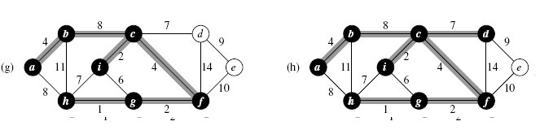
Example

Slide 8
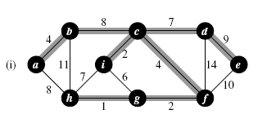
Example

Slide 9
Analysis
If Q is implemented as a binary min-heap we can use the BUILD-MIN-HEAP procedure to perform the initialization in lines in O(V) time.
The body of the while loop is executed |V| times, and since each EXTRACT-MIN operation takes O(lg V) time, the total time for all calls to EXTRACT-MIN is O(V lg V).
The for loop in lines 8–11 is executed O(E) times altogether, since the sum of the lengths of all adjacency lists is 2 |E|.
The assignment in line 11 involves an implicit DECREASE-KEY operation on the min-heap, which can be implemented in a binary min-heap in O(lg V) time.
Thus, the total time for Prim’s algorithm is O(V lg V + E lg V) = O(E lg V), which is asymptotically the same as for our implementation of Kruskal’s algorithm.

Slide 10
Improvement of Prim’s Algorithm
The asymptotic running time of Prim’s algorithm can be improved, however, by using Fibonacci heaps.
If |V| elements are organized into a Fibonacci heap, we can perform an EXTRACT-MIN operation in O(lg V) amortized time and a DECREASE-KEY operation (to implement line 11) in O(1) amortized time.
Therefore, if we use a Fibonacci heap to implement the minpriority queue Q, the running time of Prim’s algorithm improves to O(E+V lg V).

